Slide 1

UMOS, LATINA RESOURCE CENTER
WISCONSIN REGIONAL ANTI-HUMAN TRAFFICKING PROGRAM
Labor Trafficking
Date: 06/24/2021 Time: 10:50-11:30AM
Joint Enforcement Task Force on Payroll Fraud and Worker Misclassification
Presenter: Mariana Rodriguez-Director, UMOS, Latina Resource Center
Presenter: Javier Acevedo-Lead Victim Advocate

Slide 2
DISCLAIMER
This training session was produced by UMOS, Inc. under [2019-VT-BX-0102], awarded by the Office of Justice Programs, U.S. Department of Justice. The opinions, findings, and conclusions or recommendations expressed in this session are those of the contributors and do not necessarily represent the official position or policies of the U.S. Department of Justice.” The OJP grant manager will determine whether minor deliverables, such as webinars, one-page flyers and discrete web pages, require review or prior approval by OJP.

Slide 3
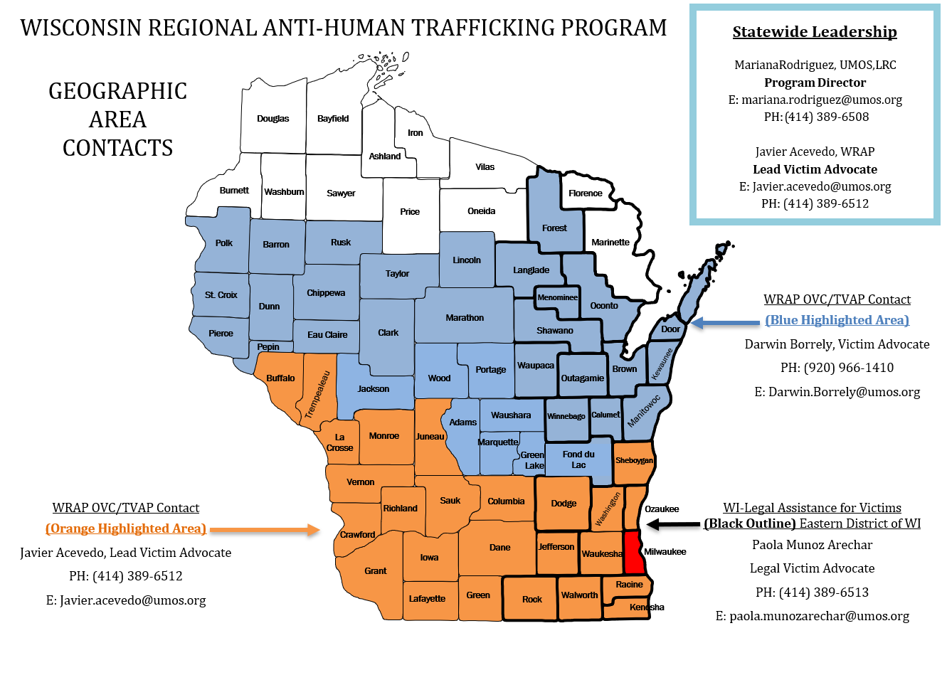
PROGRAM SERVICES
  Outreach
  Public Awareness
  Training
  Screening and Identification
  Technical Assistance
  Advocacy
  Collaboration
  Policy Development

Slide 4
UMOS ANTI-HUMAN TRAFFICKING SERVICES
“OVC”
Office of Victims of Crime
“TVAP”
Trafficking Victims Assistance Program
Direct Services Model. Emergency funds for victims
of trafficking. Foreign born, domestic,
Adult, or child.
Emergency funding for foreign
National victims of trafficking
“LAV”
Legal Assistance for Victims Grant
“OVC”
Office of Victims of Crime
Legal assistance in conjunction
With Lotus Legal Clinic, providing
Legal relief for victims of non-intimate
Sexual violence in the Eastern District
Of Wisconsin.
ENHANCED COLLABORATIVE MODEL: Subcontract-Madison County
(NEW AWARD)
Project Respect & DCI
(Department of Criminal Investigations-HT Taskforce)

Slide 5
HUMAN TRAFFICKING IN WISCONSIN

Slide 6
WISCONSIN VULNERABILITIES
EASILY ACCESSIBLE HIGHWAY SYSTEM
RICH AGRICULTURAL INDUSTRY
HOSPITALITY INDUSTRY AND TOURISM

Slide 7
Intersections labor Trafficking VS. Labor Exploitation
Labor Trafficking
Presence of force, fraud or coercion
Limited or no freedom of movement (an actual or psychological conviction-because of force/fraud/coercion
No freedom to leave without fear of harm or retaliation
Unfair wages or wage theft
Substandard working conditions
Substandard living conditions
Labor Exploitation
Freedom of Movement
Freedom to leave employment
Unfair wages or wage theft
Worker can quit or change job
Employer exploits agreement with worker
Both
Unfair wages or wage theft
Substandard Working Conditions
Substandard Living Conditions

Slide 8
HUMAN TRAFFICKING: WHAT IS IT?
Human trafficking is a form of modern-day slavery
Victims of trafficking exploited for commercial sex or labor purposes
Traffickers use force, fraud or coercion to ultimately achieve the exploitation
Notes:
Human trafficking is a human rights violation that takes place not only internationally, but also here in Wisconsin.
It is, indeed, a form of modern-day slavery.
Traffickers use force, fraud or coercion to enslave their victims into situations involving sexual exploitation or forced labor.
Human trafficking is the fastest growing criminal industry in the world today, often operated by organized crime syndicates.

Slide 9
VICTIMS CAN BE FOUND IN
  Domestic Service Situations
  ( As Nannies Or Maids)
  Construction Sites
  Hospitality
  Raising Animals
  Farm/Migrant/Agricultural Work
  Guest Worker Programs
  Dairy Farms
  Restaurants/Bars/Pubs
  (Among Many Other Industries)

Slide 10
TVPA 2000: FEDERAL DEFINITION
As defined by the Trafficking Victims Protection Act of 2000:
Labor Trafficking: The recruitment, harboring, transportation, provision, or obtaining of a person for labor or services, through the use of force, fraud or coercion for the purpose of subjection to involuntary servitude, peonage, debt bondage, or slavery

Slide 11
HOW TVPA AFFECTS WHAT YOU DO
Creates new laws that criminalize trafficking regarding slavery, involuntary servitude, peonage or forced labor
Permits prosecution where non-violent coercion was used to force victims to work in belief, they would be subject to serious harm
Permits prosecution where victim's service compelled by confiscation of documents such as passports or birth certificates
Increases prison terms for all slavery violations from 10 years to 20 years; adds life imprisonment where violation involves death, kidnapping, or sexual abuse of victim
Requires courts to order restitution, forfeiture of assets upon conviction
Enables victims to seek witness protection, other types of assistance
Gives prosecutors and agents new tools to get legal immigration status for victims of trafficking during investigation, prosecution
Notes:
TVPA imposes stricter sentences on those convicted of committing crimes of human trafficking.
For example, if a trafficking crime results in death or if the crime includes kidnapping, an attempted kidnapping, aggravated sexual abuse, attempted aggravated sexual abuse, or an attempt to kill, the trafficker could be sentenced to life in prison. Traffickers who exploit children (under the age of 14) using force, fraud or coercion, for the purpose of sex trafficking can be imprisoned for life. If the victim was a child between the age of 14 and 18 and the sex trafficking did not involve force, fraud or coercion, the trafficker could receive up to 20 years in prison.
Moreover, the law addresses the subtle means of coercion used by traffickers to bind their victims into servitude, including: psychological coercion, trickery, and the seizure of documents, activities which were difficult to prosecute under preexisting involuntary servitude statutes and case law.

Slide 12
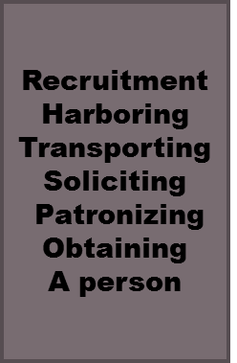
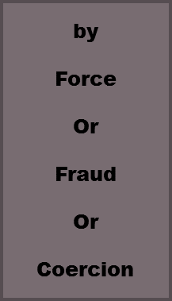
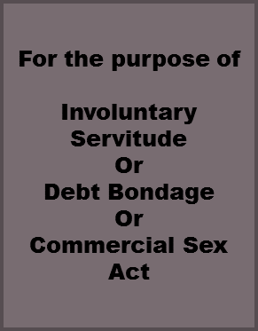

THREE ELEMENTS NECESSARY TO MEET TRAFFICKING DEFINITION-A.M.P MODEL
1. Action 2. Means 3. Purpose

Slide 13
HUMAN TRAFFICKING
WI STATUTE (Wis. Stat. § 940.302)

Slide 14
ACTION | MEANS: DONE BY ANY OF THE FOLLOWING | FOR THE PURPOSE OF:
Recruiting Or Enticing Or Harboring Or Transporting Or Providing Or Obtaining …An individual Or Attempting to do so | Causing or threatening to cause bodily harm to any individual Or Causing or threatening to cause financial harm to any individual Or Restraining or threatening to restrain any individual Or Violating or threatening to violate a law Or Destroying, concealing, removing, confiscating, possessing, or threatening to destroy, conceal, remove, confiscate, or possess any actual or purported passport or any other actual or purported official identification document of any individual Or Extortion Or Fraud or Deception Or Debt Bondage Or Controlling any individual’s access to an addictive-controlled substance Or Using any scheme, pattern, or other means to directly or indirectly, coerce, threaten, or intimidate any individual Or Using or threatening to use force or violence on any individual Or Causing o threatening to cause any individual to do any act against the individual’s will or without the individuals Consent | Labor Or Services Or A Commercial Sex Act NOTE: A person under 18 years of age induced to perform a commercial sex act is a victim of trafficking regardless of whether force, fraud or coercion is used.
Notes:
Sex trafficking operations occur in highly visible venues such as street prostitution, as well as more underground locations such as closed-brothel systems that operate out of residential homes.
Sex trafficking also takes place in a variety of public and private locations such as massage parlors, spas, strip clubs and other fronts for prostitution. Victims may start off dancing or stripping in clubs and are often coerced into more exploitative situations of prostitution and pornography

Slide 15
INDICATORS OF LABOR TRAFFICKING
EVIDENCE OF CONTROL AND LACK OF ABILITY TO MOVE FREELY OR LEAVE JOB
UNTREATED WORK-RELATED INJURIES
NOT IN CONTROL OF EARNED WAGES
UNSUAL DEDUCTIONS FROM WAGES (RENT,UTILITIES, RECRUITMENT,TRANSPORTATION)
HAS BEEN FORCED TO WORK IN SEVERAL STATES SINCE ARRIVING IN THE US TO WORK UNDER THE FEDERAL GUEST WORKER PROGRAM
THREATS OF DEPORTATION OR INVOLVING LAW ENFORCEMENT
THREATS OF BLACKLISTING OR CAUSING REPUTATIONAL
WORKER EXPRESSES THAT HIS OR HER WORK/LIVING CONDITIONS ARE EXTREMELY DIFFERENT THAN WHAT WAS INITIALLY OFFERED.
INTENSE FEAR OR DEPRESSION
FEAR OF EMPLOYER RETALIATION
LACK OF ID OR IMMIGRATION DOCUMENTS (OR IN POSSESSION OF FALSE ID)
Notes:
Once you think you have encountered human trafficking, there are other key factors you’ll need to consider when identifying potential victims and distinguishing them from the real criminals – their traffickers.
A person who is trafficked may look like anyone you encounter at a crime scene, but sensitively asking the right questions and looking for small clues will help you identify those people who have been fraudulently induced, forced or coerced into a life of sexual exploitation or forced labor. Look for the following clues: [Refer to list of clues on the slide]
You should also take into consideration victims’ cultural and social background as these traits will impact the way victims should be managed as witnesses, as well as the way the investigation of their cases is carried out.
Victims may not be able to communicate with you because of language or cultural barriers.
Victims often have a fear of being deported.
Victims may appear to you as a prostitute or a willing participant in the trafficker’s enterprise.
Victims frequently do not self-identify themselves as victims.
Victims may display an allegiance to their trafficker/employer.

Slide 16
COMMON WORK & LIVING CONDITIONS
IS NOT FREE TO LEAVE OR COME AND GO AS HE/SHE WISHES (FREEDOM OF MOVEMENT)
IS UNPAID, PAID VERY LITTLE, OR PAY IS GARNISHED
WORKS EXCESSIVELY LONG AND/UNUSUAL HOURS
IS NOT ALLOWED BREAKS OR SUFFERS UNDER UNUSUAL RESTRICTIONS AT WORK
FOOD/SLEEP DEPRIVATION (WHAT TIME IS BREAKFAST? LUNCH? DINNER? ACCESS TO WATER ?)
OWES A LARGE DEBT AND IS UNABLE TO PAY IT OFF
WAS RECRUITED THROUGH FALSE PROMISES CONCERNING THE NATURE AND CONDITIONS OF THEIR WORK
SECURITY MEASURES EXIST IN THE WORK AND/OR LIVING LOCATIONS (BOARDED WINDOWS, BARS ON WINDOWS, ETC.)
LIVES IN EMPLOYER PROVIDED HOUSING (CONSIDER THE CONDITIONS OF THE PROPERTY-PESTS, HEAT, WATER, STOVE, REFRIGERATOR-LIVABLE? OR UNLIVABLE?)
H2A CONTRACTORS MUST OBEY CERTAIN REGULATIONS WITH REGARD TO HOUSING WORKERS. (STATE MONITORS HELP REGULATE)

Slide 17
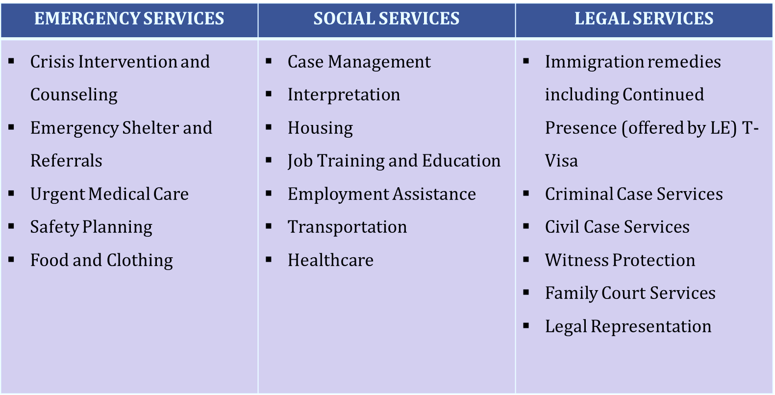
NEEDS OF VICTIMS
ANTI-HUMAN TRAFFICKING ADVOCACY

Slide 18
GETTING VICTIMS, THE HELP THEY NEED
If you think you have come in contact with victim of human trafficking, call National Human Trafficking Hotline, 1.888.373.7888.
This hotline will help you:
  Determine if you have encountered victims of human trafficking
  Identify local community resources to help victims
  Coordinate with local social service organizations to help protect and serve victims so they begin process of restoring their lives
For more information on human trafficking visit www.acf.hhs.gov/trafficking
UMOS Latina Resource Center 414-389-6510 (Bilingual)
  Identify local community resources to help victims
  Coordinate with local social service organizations to help protect and serve victims
  Connect foreign born victims to local, state & Federal services
Call local police if victim is at risk of imminent harm
Notes:
The first step in providing assistance to trafficking victims is to call the Trafficking Information and Referral hotline. However, if the victim is at risk for imminent harm, first call the local police.
This hotline will help you determine if you have encountered victims of human trafficking, will identify local resources available in your community to help victims, and will help you coordinate with local social service organizations to help protect and serve victims so they can begin the process of restoring their lives.
Victims of human trafficking who are non-U.S. citizens are eligible to receive a special visa and benefits and services through the Trafficking Victims Protection Act to the same extent as refugees. Victims who are U.S. citizens are already eligible to receive many of these benefits.

Slide 19
UMOS, LATINA RESOURCE CENTER
WISCONSIN REGIONAL ANTI-HUMAN TRAFFICKING PROGRAM
Mariana Rodriguez-Program Director
P: (414) 389-6508 E: Mariana.Rodriguez@umos.org
Javier Acevedo-Lead Victim Advocate
P: (414) 389-6512 E: Javier.Acevedo@umos.org
Darwin Borrely-Victim Advocate
P: (920) 410-2969 E: Darwin.Borrely@umos.org
Paola Munoz Arechar-Legal Victim Advocate
PH: (414) 389-6513 E: paola.munozarechar@umos.org

